Slide 1


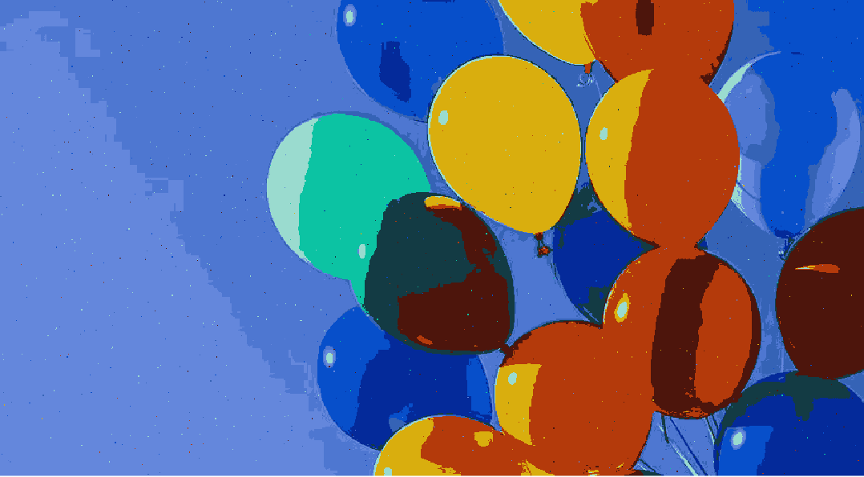
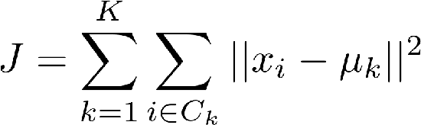
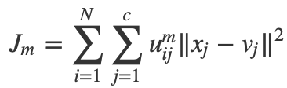
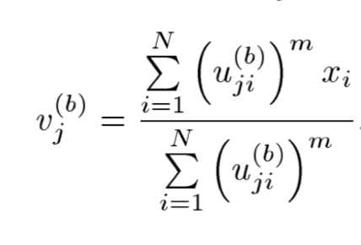
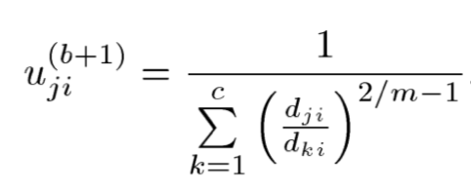
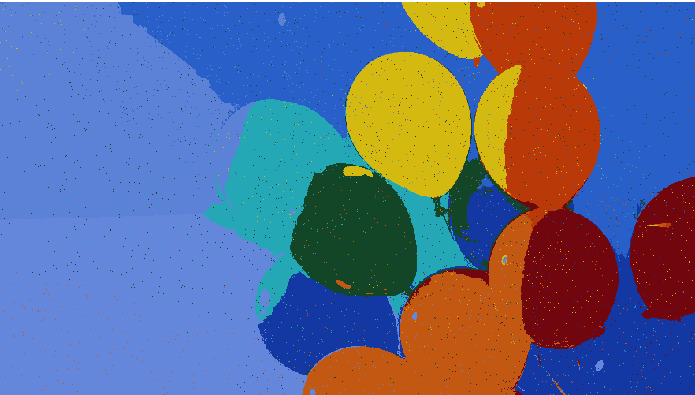

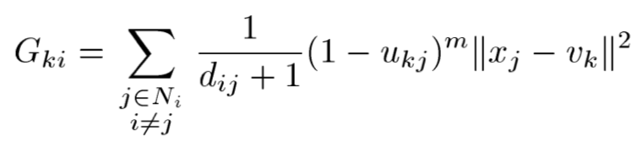
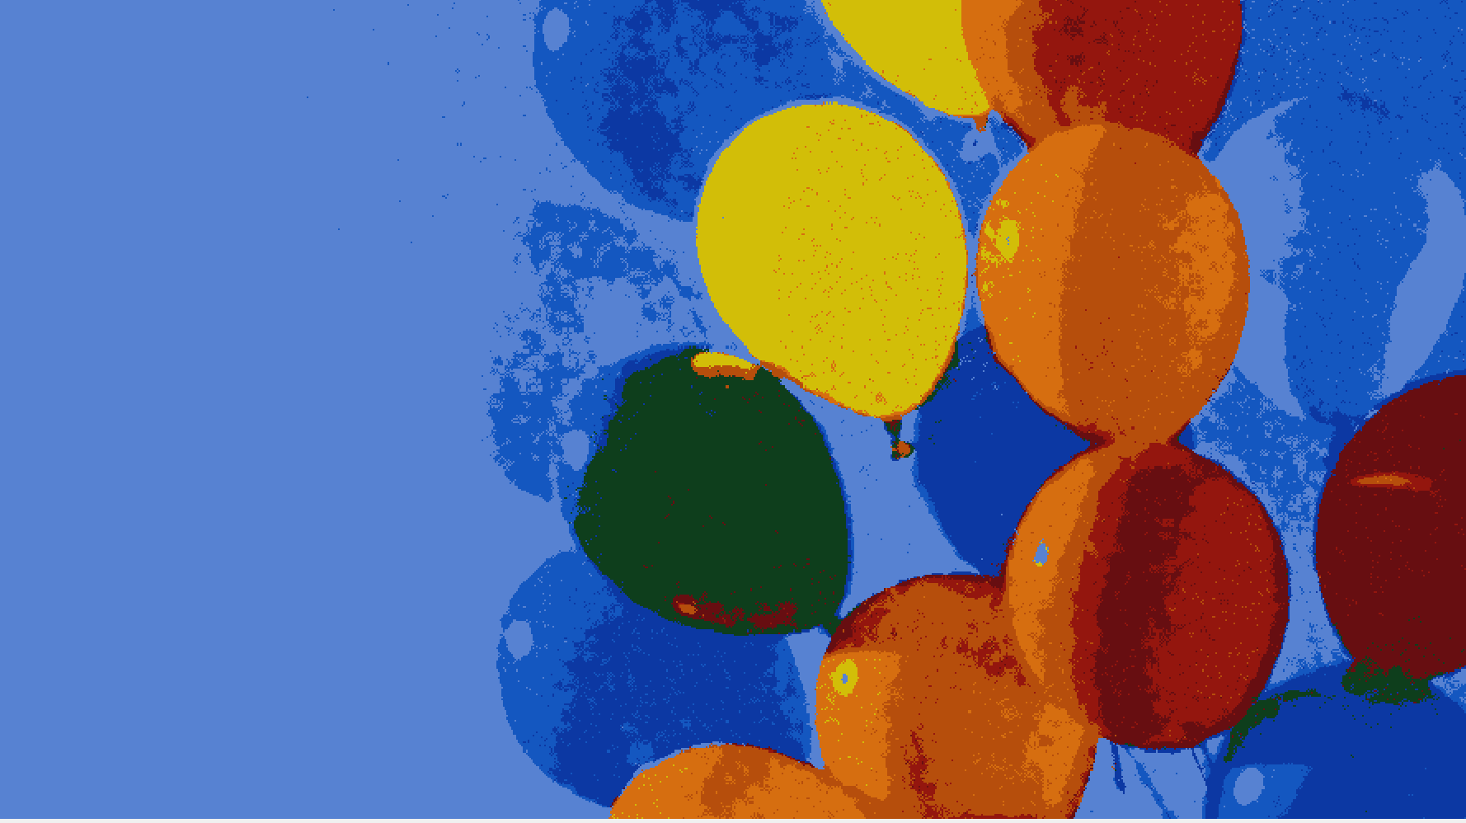
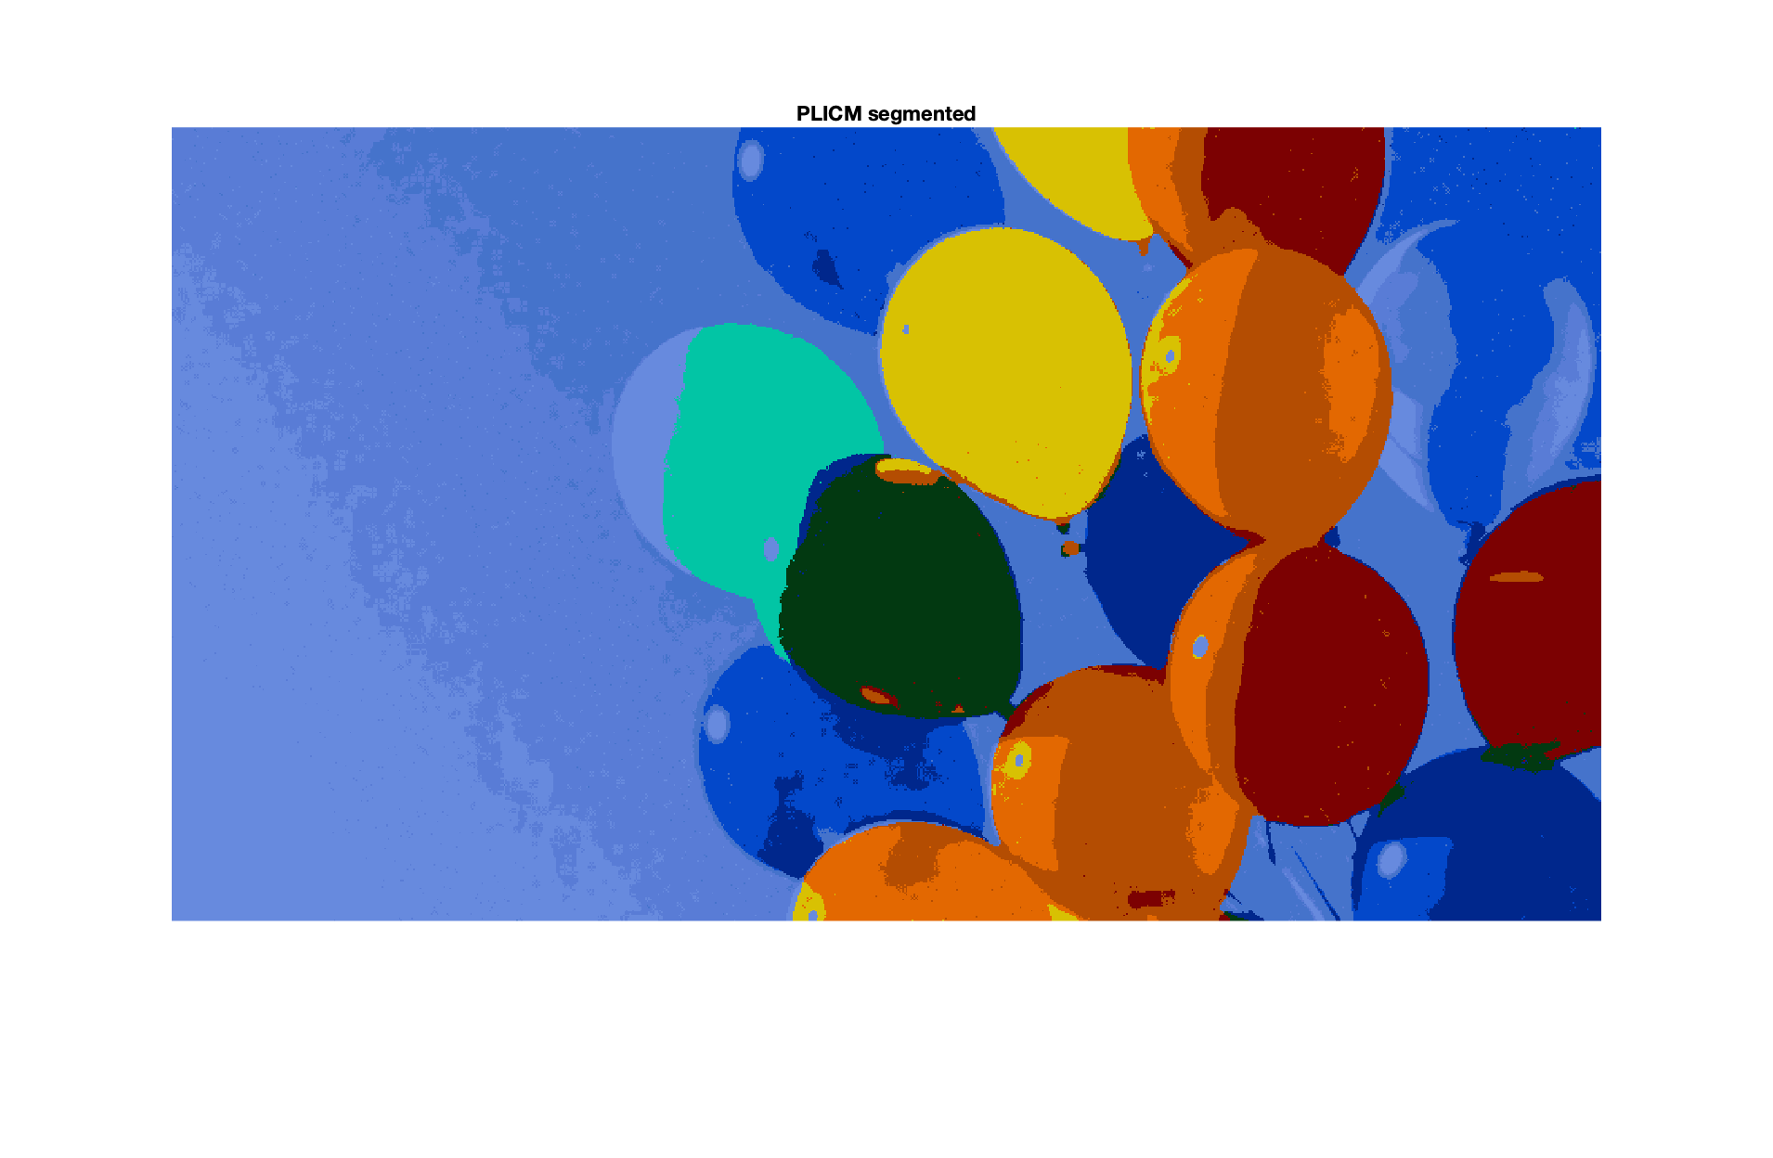
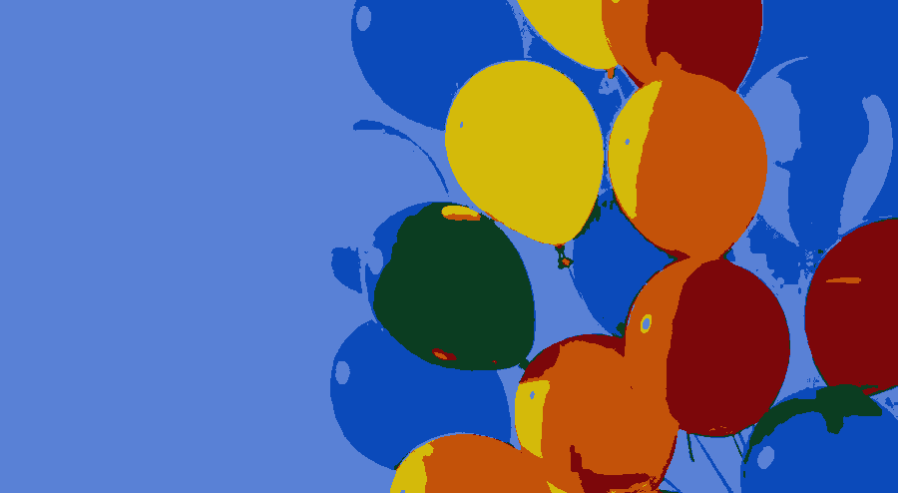
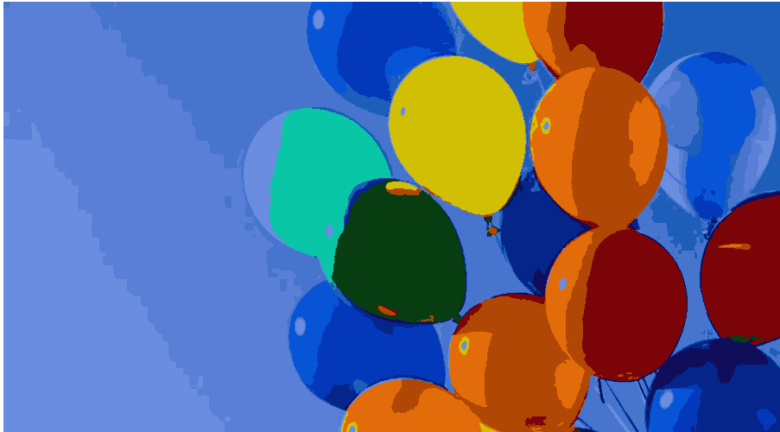
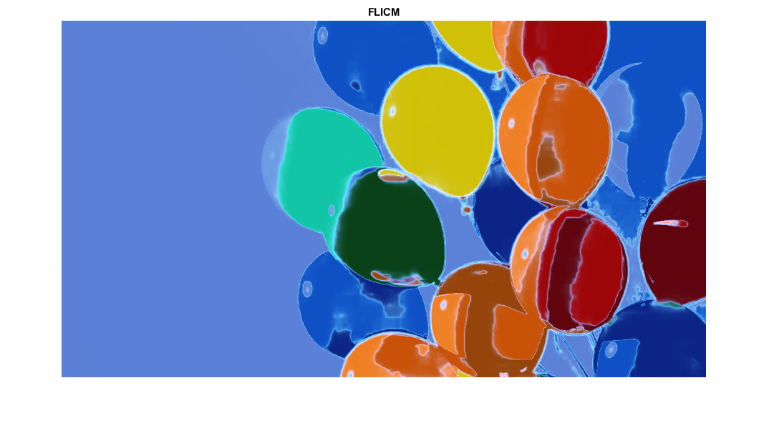
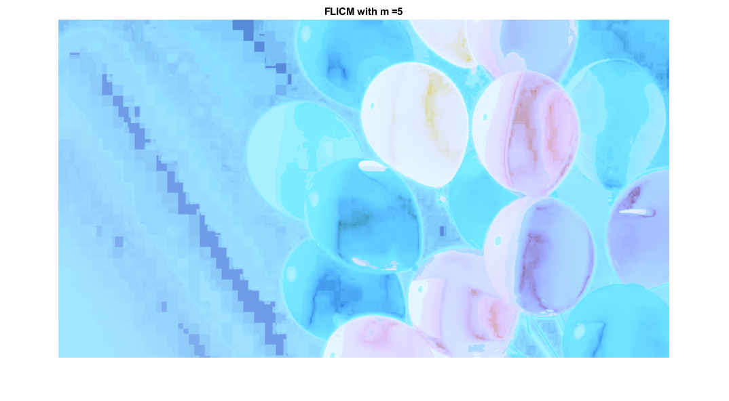

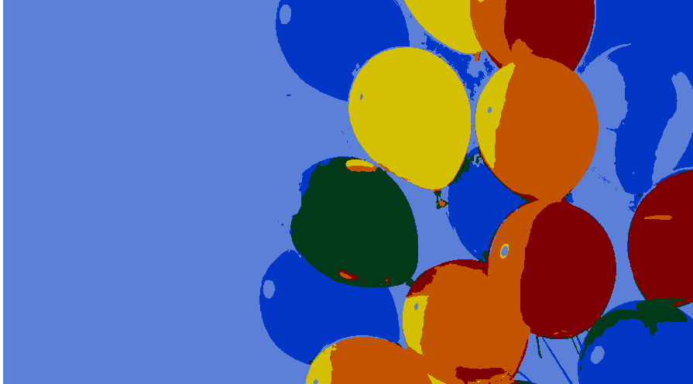
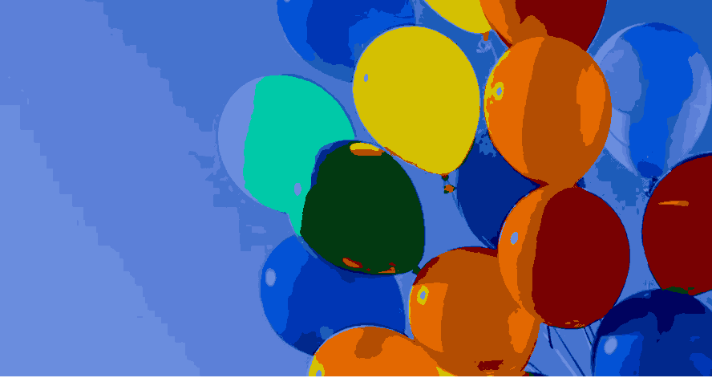
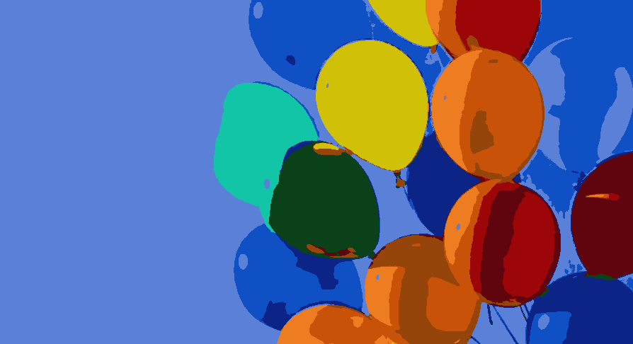
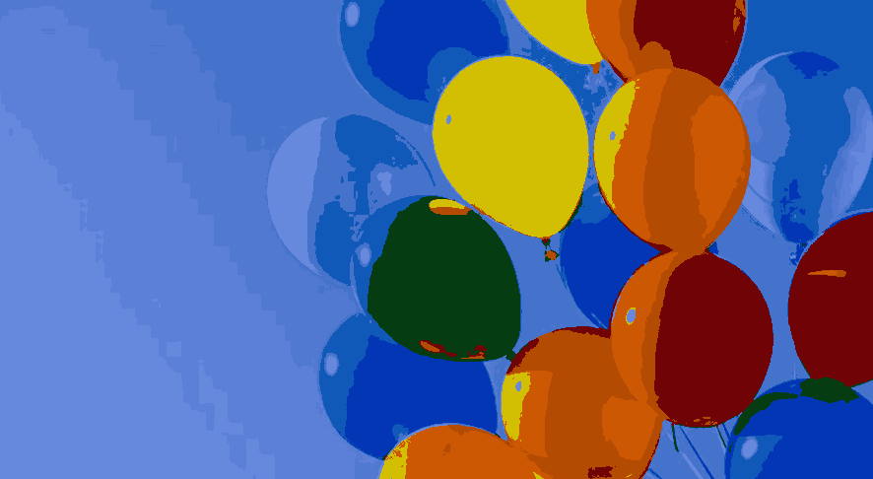
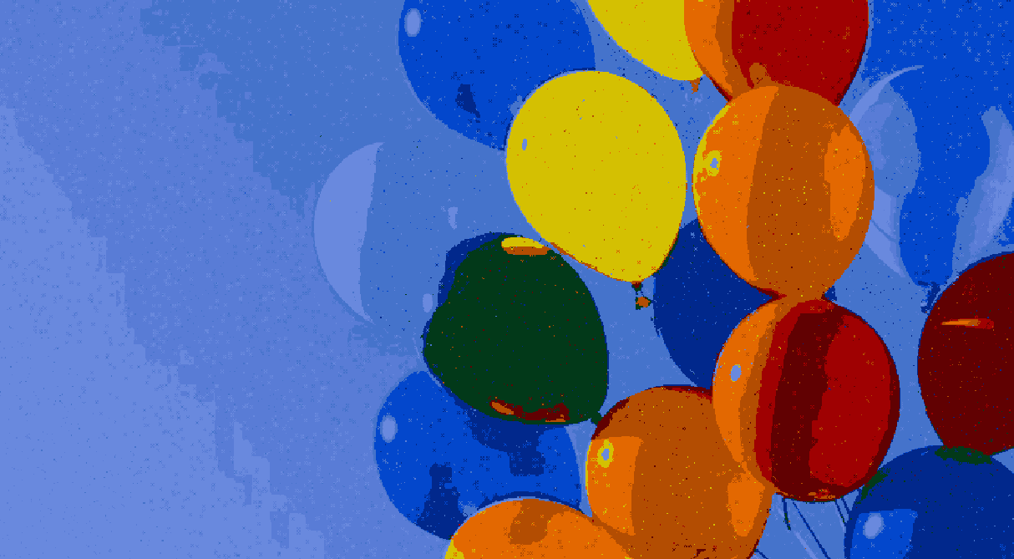


COMPARISON OF FLICM, PLICM, SPLI1M, AND CRISP CLUSTERING FOR IMAGE SEGMENTATION
Aaron Neidlinger - Alicia Esquivel Morel - Dewi Kharismawati - Evan Teters - Jacob Krajewski
Department of Electrical and Computer Engineering,
University of Missouri, Columbia, U.S.A.
Image segmentation is the most important task in image analysis and computer vision. In crisp clustering, like k-means, one pixel just belongs to one cluster, which it is not effective when the image has some issues such as poor contrast, overlapping intensities, and noise. Fuzzy clustering, such as FCM, become the alternative since it has degree of membership on each cluster for each pixel. However, FCM is not working well on noisy images. Then, Fuzzy Local Information C-Means (FLICM) is introduced to tackle FCM problem on noisy images by enforcing local neighborhood to get the local boundary of the object. However, sum-to-one constraint in FLICM still lead into problem when the local spatial position information of specific noise pixels is ambiguous. This problem is solved by Possibilistic Local Information C-Means (PLICM). PLICM is designed to be more robust against noise without sum-to-one constraint. However, algorithm above will fails under coincident cluster, when actual positive clusters in the image is less than cluster initialization. Fortunately, Sequence Possibilistic Local Information 1 Means is introduced to solve this problem. SPLI1M is basically run possibilistic local information one means sequentially until all local consistent clusters are found. Therefore, this project is designed to investigate the performance of those algorithm for image segmentation.
Theory Overview
Result
Analysis
K-means–Crisp Clustering
K-means is a type of clustering algorithm that subdivide data points of dataset into cluster based on nearest mean values.
FCM
Fuzzy C-means clusters allows each data point to belong into two or more clusters.
FLICM
Fuzzy Local Information C-means (FLICM) is FCM that maintain the spatial information to localize region of interest.
PLICM
Possibilistic Local Information C-means is FLICM that abandoned sum-to-one cluster. Fails when actual positive clusters in the image is less than cluster initialization.
SPLI1M
Sequence Possibilistic Local Information 1 Means solving coincident clusters. SPLI1M runs possibilistic local information one means sequentially until all local consistent clusters are found.
Experiment 1: Noise Comparison
(a) original image with noise (b) k-means with k=11
(c) k-means with local information (d) FCM with k = 11
(e) FLICM with k=11 w=7 (d) PLICM with k=11 w=7
Experiment 2: number of cluster in PLICM
(a) FLICM k = 6 (b) FLICM k=14
(c) PLICM k = 6 (d) PLICM k=14
Experiment 3: Different Fuzzifier
(a) FLICM m = 1.5 (b) FLICM m=5
Experiment 4: Different Window Size
(a) PLICM w = 3 (b) PLICM w=7
(c) PLICM w = 13 (d) PLICM w=17
The first experiment was the most interesting finding in this project. It compares the performance of each algorithm on noisy images. K-means surprisingly can remove noise very well, but fails to segment individual balloons. On the other hand, k-means with spatial information segments individual balloons better, but fails to remove noise. FCM did not remove noise well and did weird segmentation. Whereas, FLICM removed noise in some part but did not in others, especially in the balloons area. However, as expected, PLICM worked best to remove noise and to segment the noisy balloon image. This is because PLICM has local information and abandoned sum-to-one constraints.
In the second experiment, we found out that cluster number that preassigned impacted the result. In k=6 in both FLICM and PLICM failed to segment the most left balloon, but k=14 did.
In the third experiment, we found that the higher the number, the more the membership is “fuzzied” and the harder it is for the algorithm to differentiate between the clusters
Finally in the last experiment, window size drastically affects FLICM’s ability to cope with noise. With a window size of 3 most of the noise remains in the segmented image. A window size of 7 removes most of the noise from the image. Our final test with a window size of 13 removed practically all noise from the segmented image and was nearly indistinguishable from tests without any noise at all. Increasing the window size allows the algorithm to handle noise better but decreases the performance.
Experiment
Four main experiments was conducted and mainly to investigate how well the algorithm deal with noise and how the parameters on each algorithm affecting the cluster performance.
Experiment 1 is comparing how good the k-means, k-means+spatial information, FCM, FLICM, and PLICM when dealing with noisy image under the same environment. Salt and pepper noise was added to the balloons image with noise density of 0.001.
Experiment 2 is comparing how well the cluster result with different number of cluster assignment on FLICM and PLICM. K=6 and K=14 was implemented.
Experiment 3 is investigating the effect of picking fuzzifier on FLICM. Fuzzifier m=1.5 and 5 was implemented
Experiment 4 is investigating the effect of window size on algorithms with local information to see how well they cluster and remove noise on the image.
References
[1] Peeples, Joshua, et al. “Possibilistic Fuzzy Local Information C-Means with Automated Feature Selection for Seafloor Segmentation.” Detection and Sensing of Mines, Explosive Objects, and Obscured Targets XXIII, 2018.
[2] Krinidis, Stelios, and Vassilios Chatzis. “A Robust Fuzzy Local Information C-Means Clustering Algorithm.” IEEE Transactions on Image Processing, vol. 19, no. 5, 2010, pp. 1328–1337.
[3] Wu, Wenlong, et al. “Sequential Possibilistic One-Means Clustering with Dynamic Eta.” 2018 IEEE International Conference on Fuzzy Systems (FUZZ-IEEE), 2018.
[4] Runkler, Thomas A., and James M. Keller. “Sequential Possibilistic One-Means Clustering.” 2017 IEEE International Conference on Fuzzy Systems (FUZZ-IEEE), 2017.
[5] Celik, Turgay, and Hwee Kuan Lee. “Comments on ‘A Robust Fuzzy Local Information C-Means Clustering Algorithm.’” IEEE Transactions on Image Processing, vol. 22, no. 3, 2013, pp. 1258–1261.

